Slide 1
Building Blocks [hash functions]

Slide 2

Hash functions
to ‘chop’ or ‘make a mess’
mathematical hash functions:
any size input
fixed size output
efficiently computable, i.e. O(n)
Notes:
-the term "hash" comes by way of analogy with its non-technical meaning, to "chop and mix". Indeed, typical hash functions, like the mod operation, "chop" the input domain into many sub-domains that get "mixed" into the output range to improve the uniformity of the key distribution.
-SHA (Secure Hash Algorithm)

Slide 3
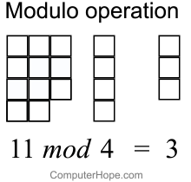
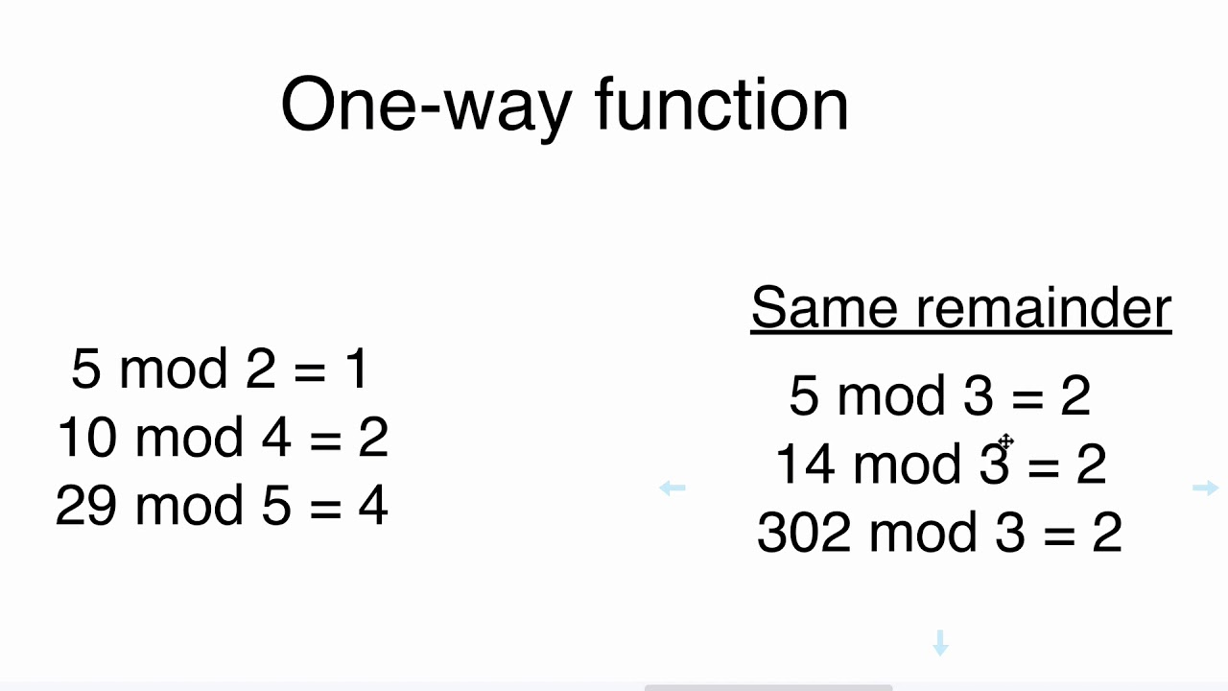
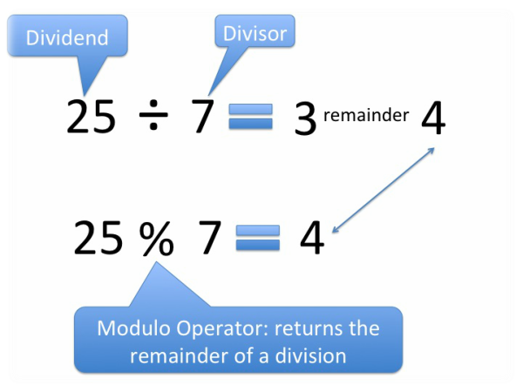
Mathematical Hash functions
e.g. the mod operation (%)

Slide 4

Hash functions
cryptographic hash functions:
collision resistance
hiding
puzzle-friendliness*
Notes:
* - for purposes of cryptocurrencies

Slide 5
Collision resistance
a hash function H is said to be collision resistant if it is infeasible to find two values, x and y, such that x≠y, yet H(x)= H(y)
x
H(x)=H(y)
y
application – message digests
file integrity
cloud storage
Notes:
-collisions – the basic counting argument (infinite input space, finite output space)
-guaranteed collision -> 2^(256)+1 distinct inputs will lead to a collision (100% chance of collision)
-birthday paradox – 2^(128) tries on average (50% chance of collision?)
-if a computer calculates 10,000 hashes per second, it would take more than one octillion years (10^27) years to calculate 2^128 hashes
-if all computers in existence were hashing since the beginning of the universe, odds are far less of finding a collision than the odds that the Earth will be destroyed by a giant meteor in the next two seconds

Slide 6

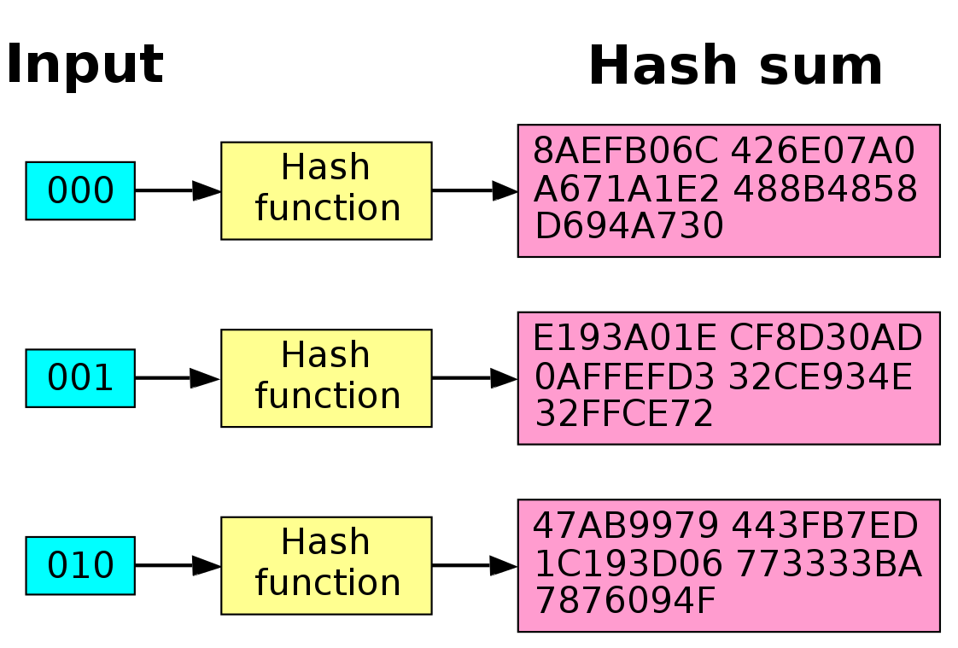
Avalanche effect
a small change in the input results in a significant change in the output
statistically indistinguishable from random

Slide 7
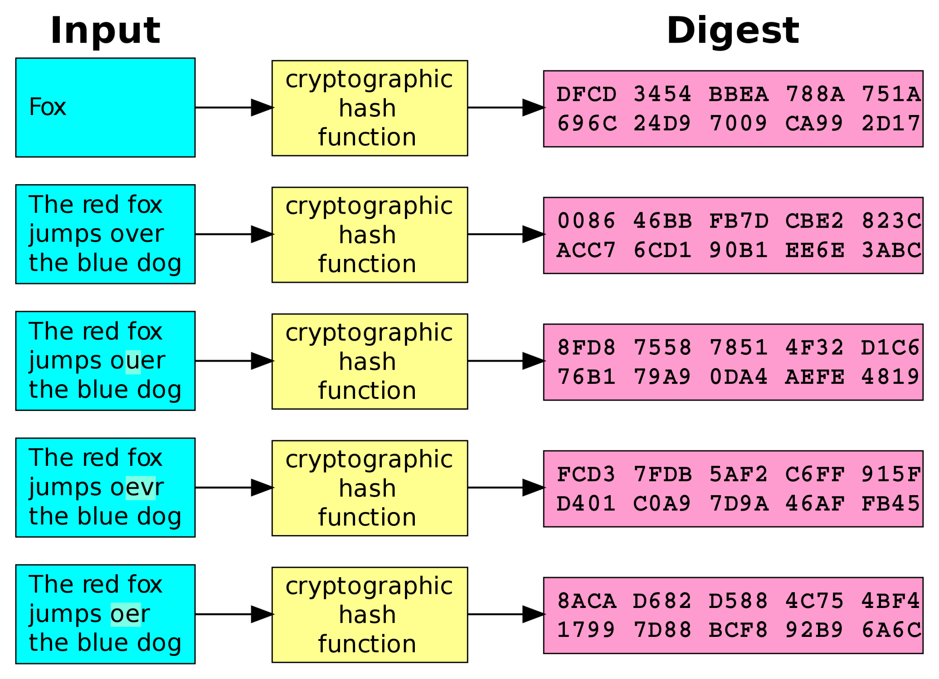
Avalanche effect

Slide 8
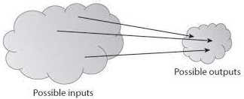
Collision resistance
do collisions exist?
‘infeasible’ – estimates?
broken hash functions
Notes:
-collisions – the basic counting argument (infinite input space, finite output space)
-guaranteed collision -> 2^(256)+1 distinct inputs will lead to a collision (100% chance of collision)
-birthday paradox – 2^(128) tries on average (50% chance of collision?)
-if a computer calculates 10,000 hashes per second, it would take more than one octillion years (10^27) years to calculate 2^128 hashes
-if all computers in existence were hashing since the beginning of the universe, odds are far less of finding a collision than the odds that the Earth will be destroyed by a giant meteor in the next two seconds

Slide 9
hiding
the hiding property asserts that given the output of the hash function y=H(x), it is infeasible to compute the input x
x must be from a *large* set
what if x is from a small set?
a hash function H is said to be hiding if when a secret value r is chosen from a probability distribution that has high min-entropy, then, given H(r||x), it is infeasible to find x
Notes:
-the function should essentially be irreversible
-if x is from a small set (e.g. heads and tails), we can easily brute force it
-min-entropy is a measure of predictability. High min-entropy means distribution is very spread out.
-for 256 bits long strings, uniform sampling means each string has probability 1/2^256

Slide 10
hiding
application: commitment scheme
sealed envelope analogy
com := commit (msg, nonce)
verify := (com, msg, nonce)
the rule of the nonce
collision resistance - binding property
Galileo to Kepler (1610)
smaismrmilmepoetalevmibunenugttaviras
altissimum planetam tergeminum observari
‘I have seen the uppermost planet triple’
Notes:
-output of commit algorithm – returns commitment
-verify algorithm returns true or false
-commit algo is equivalent to putting sealed envelope on table – looking at envelope/commitment does not reveal original message
-verify algo is equivalent to verifying the message
-nonce etymology - Contraction of number used once
-binding property – it is infeasible to find two pairs (msg,nonce) and (msg’,nonce’) such that msg ≠msg’ and H(nonce||msg) ≠H(nonce’||msg’)
-anagram is not a true hash -Why, you may wonder, did Galileo announce his finding in such bizarre a fashion? Apparently, this wasn’t unusual at the time. Before the existence of scientific journals, short of publishing a very expensive book, the way of establishing priority was to write about the discovery to a famous scientist. Of course, you had to phrase your letter carefully so as not to actually reveal the discovery explicitly, lest the famous person would take credit for the work. This ingenious method of “publication” established priority, while at the same time communicating it to the person most likely to snatch the priority from you. If anyone else announced that Saturn had two blobs next to it, Galileo could unscramble the anagram and show that he’d seen them first. Kepler would serve as his expert witness.
Kepler unscrambled the anagram wrongly to “Salve, umbistineum geminatum Martia proles,” and interpreted this to mean “Mars has two moons.” The translation is very bad since it contains a declension, “umbistineum,” that does not even exist in Latin. This American Life tells us it means “Hail, double-knob children of Mars.”
Of course, Mars does have two moons, but neither Kepler nor Galileo had any way of knowing that. (Nobody did until 1877, when both these gentlemen were already dead.)
(http://judgestarling.tumblr.com/post/62652246148/galileo-kepler-two-anagrams-two-wrong)

Slide 11
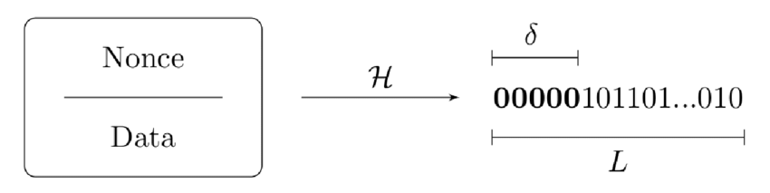
Puzzle friendliness
a hash function is puzzle friendly if no solution exists to find the input to a given output, which is better than just making random guesses. Thus, the only way to find a solution is brute force.
a hash function H is said to be puzzle friendly if for every n-bit output value y, if k is chosen from a distribution with high min-entropy, then it is infeasible to find x such that H(k||x) = y in time significantly less than 2^{n}

Slide 12

Puzzle friendliness
application: search puzzle
searching space to find solution
H(x) ε Y
Y is the target set
difficulty of puzzle depends on size of Y
application: proof of work
combating spam (Hashcash)
essential property for mining
Notes:
-no shortcuts to search
-if Y is set of all n-bit strings, puzzle is trivial
-if Y has one element, puzzle is maximally hard
-if id is a likely value, someone could precompute puzzle solution (brute force)

Slide 13
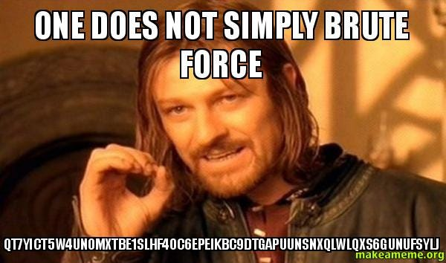
Puzzle friendliness
Notes:
-IR plan – Incident Response

Slide 14
resources
Chap 1: Intro to Cryptography and Cryptocurrencies Bitcoin and Cryptocurrency Technologies: A Comprehensive Introduction
Hash Functions (Nakamoto.com) (link)
Overview of Hashcash (Nakamoto.com) (link)
9

Slide 15
Further reading
Roy Sullivan! (link)
A good hash function is hard to find (link)
Bitcoin Puzzles: Cryptocurrency Hidden in Plain Sight (link)
SHAttered – SHA1 collision attacks (link)
Hashcash white paper (link)
10

Slide 16


humor
Notes:
-IR plan – Incident Response

